Slide 1
Display Specific Adaptation
Colour picker app

Slide 2
Aim
Investigate perception of colour specific to people’s familiar devices – i.e. their phones.
Methods
Gather participants’ adjustments for white, red, green, blue and yellow on their own phones.
Gather self-reported details of the ambient conditions, use of blue light filter app (and whether it was active at the time), device make, model and OS, how long they have had the phone, estimate of daily useage in hours, maybe other things…

Slide 3
Participant journey
Consent
(this includes participant code)
Tick box confirmation:
Have you switched off any other screen which is nearby?
Have you set Do Not Disturb?
Is the app currently filling your screen?
If not try returning to home screen then opening the app again.
Colour picker
Participant code:
Please enter the last letter of your place of birth:
Please enter the second letter of your second name:
Please enter the first letter of the street where you live:
Please enter the final digit of your mobile phone number:
Questionnaire
Participant code:
Please enter the last letter of your place of birth:
Please enter the second letter of your second name:
Please enter the first letter of the street where you live:
Please enter the final digit of your mobile phone number:
Calibration

Slide 4
Colour picker – white settings
Text and boxes in black
Central text cue to indicate what colour they are setting (always “white” for now)
Tap zones with text indicating the effects on colour
Up = + a* (redder)
Down = - a* (greener)
Right = + b* (yellower)
Left = - b* (bluer)
On each tap the whole screen changes to represent the new chromaticity based on LAB->sRGB transform, but not if the colour goes beyond the allowed eccentricity.
The change should be quite subtle (i.e. small distance in colour space) per tap, but allowing the buttons to be held down to move more quickly through colour space would be OK.
Trial starts at a random chromaticity within the allowed circle of LAB space.
R+
B+
white
Y+
G+

Slide 5
Colour picker - hue settings
+
Central text cue to indicate what colour they are setting (“red”, “green”, “yellow” or “blue”)
Tap zones above and below which change the hue clockwise/anticlockwise (marked “+” and “–”).
On each tap the whole screen changes to represent the new chromaticity based on (polar) LAB->sRGB transform
red
-

Slide 6
LAB space/gamut
In order to avoid required RGB values going beyond max/min we need to implement a limit to the range of LAB chromaticities allowed.
This limit will be in terms of the eccentricity (often called “Chroma” in LAB space). On each step, before trying to render a new RGB it will be necessary to check that the Chroma isn’t greater than allowed.
We can calculate this limit in advance, but note there will be different limits for different L* values.

Slide 7
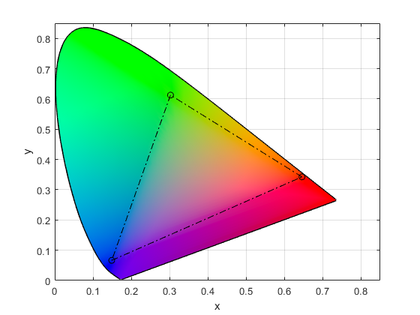
Gamut figure
Angle/Hue
White point (D65)
Eccentricity/Chroma
x
Max allowed Chroma, and the circle on which hue settings will be made
+
0 deg
Note this is shown in xy space by the principle is the same for LAB

Slide 8
Questionnaire (draft)
About your device:
What make is your phone?
What model is your phone?
Does your phone run on Android or Apple OS?
What browser do you use?
Do you use a “blue light filter” app or setting? Yes/No/Don’t know
-[If yes] Was the “blue light filter” switched on when you completed the task? Yes / No / Don’t know
What mode do you generally use your phone in? Dark mode / Light mode / Don’t know/other
Does your phone adjust brightness automatically? Yes / No / Don’t know
Does your phone adjust colour automatically? Yes / No / Don’t know
iPhone users only - Does your phone have TrueTone switched on?
Did you have any display accessibility settings on during the task?
How long have you had this phone for? (months)
Approximately how many hours per day do you spend using this phone?
Please describe any other filter apps, adjustments or display settings that you use on your device (if there are none, or you just used default settings please state "none"): _______
About your surroundings:
Where are you currently? At home / on campus
-[on campus] What room are you in?
What is the lighting like where you are sitting? Completely natural, majority natural, majority artificial, completely artificial
About you:
Age (years):
Gender: male / female / non binary / prefer to self describe ____ / prefer not to say
Have you ever been diagnosed with a colour vision deficiency ("colour blindness")? Yes / No / Not sure
Notes:
Yesesvi – make a questionnaire

Slide 9
Colorimetry
Red – L* = 40, Ch = 45 , hue < 152, hue >275
Green – L* = 45, Ch = 25, full hue circle
Blue – L* = 40, Ch = 25, full hue circle
Yellow – L* = 50, Ch = 50, hue < 155, hue > 273
White – L* = 90, max Ch = 12.5
Gamma function should be based on the sRGB standard.

